Slide 1


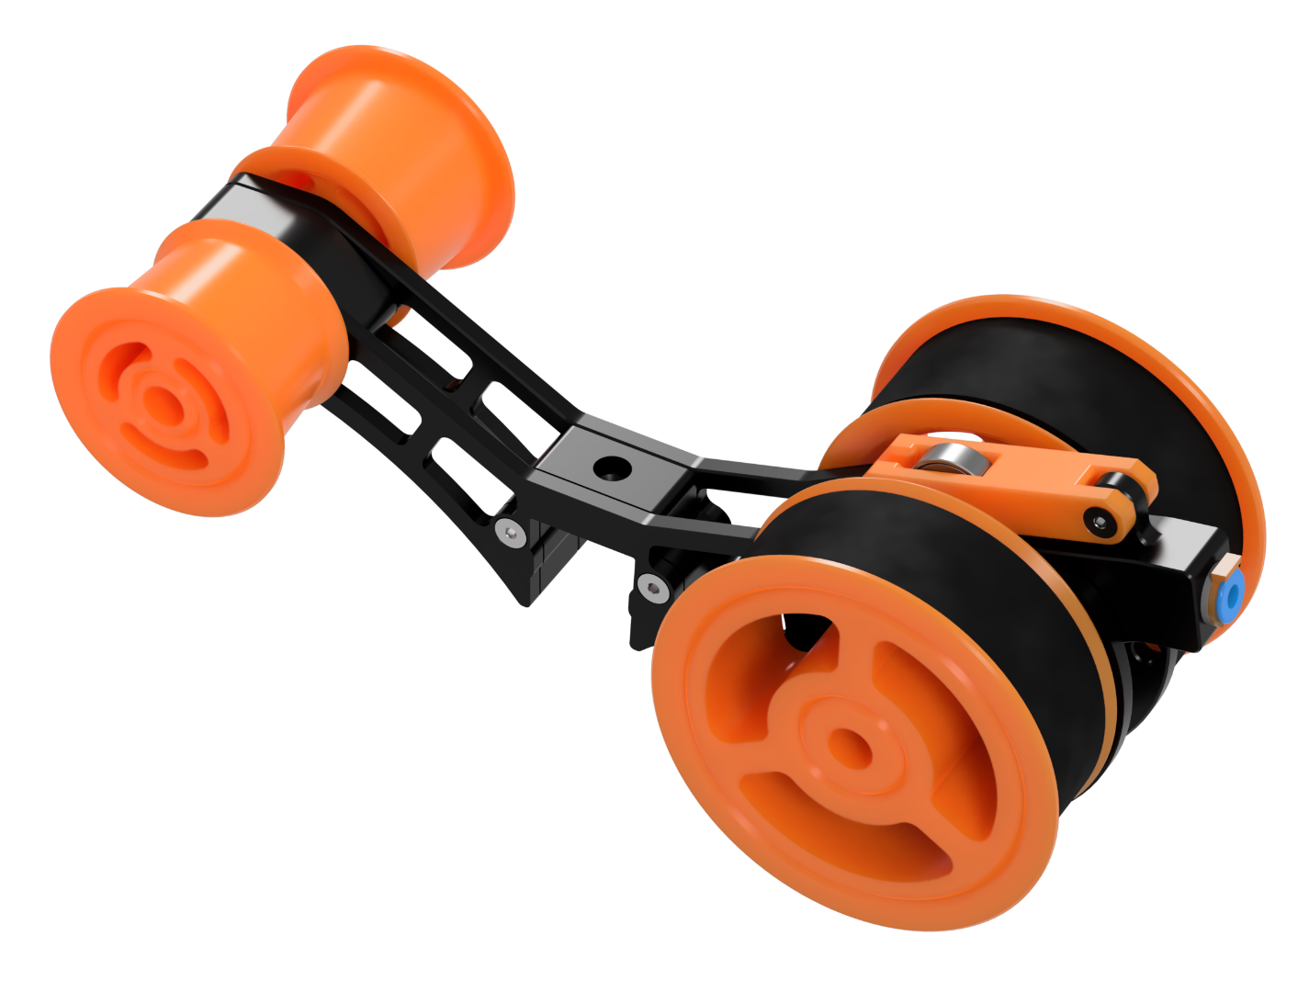
Video Assembly Guide Here!
(https://youtu.be/-1cHOcnosxE - coming soon)
User Community Help on Discord Here!
(https://discord.gg/hxe9eMWseT)
“The Filamentalist abides…”
The Dude, 1998
ERCF
FILAMENTALIST V3 BUILD GUIDE

Slide 2
FILAMENTALIST V3
TABLE OF CONTENTS
Introduction Theory of Operation | 3
Acknowledgements | 4
Configuration/Options | 5
Part Printing Guidelines | 7
STL File Naming Key | 9
Hardware Reference | 10
Required Tools | 11
CAD Files and Parametric Model | 13
Assembly | 16
Tensioner Arm | 17
Tensioner Mount | 18
Assembly (cont.)
Center Drive Roller (CDR) | 20
Chassis | 21
CDR/Tensioner Arm | 25
One-Way Bearing Orientation | 26
Rim/Idler Rollers | 27
Tuning | 28
O-Ring Replacement | 29
Questions, Troubleshooting, and Help | 30
Be Kind Rewind
–2008 starring Jack Black and Mos Def
‹#›
‹#›

Slide 3
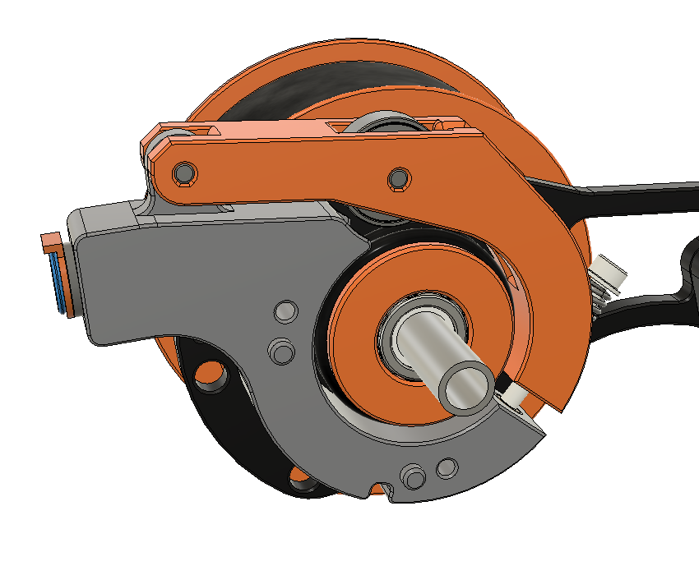
INTRODUCTION
THEORY OF OPERATION
The Filamentalist is an integrated solution for buffering and spool holding, providing space savings as well as the potential for filament path reduction, and the associated drag/resistance that comes with long runs from spool to buffer to MMU.
The Filamentalist uses the axial force delivered by the MMU gear motor along the filament to load and unload from the filament spool.
An adjustable spring clamp forces the filament against two o-rings that sit on the Center Drive Roller (CDR) to create a high traction interface, for rotating the axle and filament spool.
A one-way clutch style bearing locks against the Drive Axle and rotates the filament spool, to take up filament during an unload.
For loading and print extruding, the clutch disengages allowing for effective free-spooling of the filament spool similar to a roller style spool holder.
The difference in diameter of the filament driven CDR versus the larger Rim Roller that the filament spool sits on provides the needed gear ratio to produce enough rotations to take up, and unload a nearly empty or full filament roll.
During unloading/buffering, to account for the varying diameter of a spool from full to empty, filament tension will cause the spring loaded arm to lift a small amount and release traction from the o-rings allowing slip to occur between the filament and the o-ring interface of the rewinder (full spool = max slip, empty spool = no/minimal slip). This grip/slip modulation effectively creates a variable gear ratio allowing for clean, tight wraps during unload with a minimum of system drag.
GEAR RATIO FOR EMPTY-TO-FULL SPOOL RANGE
O-RING/FILAMENT INTERFACE
SPRING TENSION
ONE-WAY BEARING
DRIVE AXLE
‹#›

Slide 4
INTRODUCTION
ACKNOWLEDGEMENTS
I would like to acknowledgement and thank:
thisiscam (on Discord) who shared Muzi Xiaoyang's video of a filament driven rewinder and then continued to partner and share his brilliance in the evolution and optimization of the final product. The original Beta Test Team (on Discord) who provided design validation and innumerous inputs for design improvements, printability, and simplification of assembly.
Cheesefrog Grafton Biokeks Meltiseugen JCPhlux and many more…
All the Early Adopters who allowed a fleet of hundreds of rewinders to help further refine the Filamentalist, the documentation, and volume unit validation. You know who you are!
v6cl (on Discord) for his innovative F1 User Mod that was a core input to the Filamentalist V3 design.
JCPhlux for suggesting the printed clutch design
The ERCF Team for building, supporting, and allowing me to be part of this amazing ecosystem of multi-material printing solutions! Your creativity, commitment, professionalism, collaboration, generosity, and sense of community is an inspiration!
‹#›

Slide 5
INTRODUCTION
CONFIGURATION/OPTIONS CONSIDERATIONS
Things that you need to know include:
There are multiple options for the Filamentalist. Determine which versions/options you want and select the stl's to print accordingly.
Unit Width: Standard width which supports spool widths from 28mm (i.e. 200gm spools) to 74mm and custom width via the Fusion 360 parametric model
Drive and Idler Axle bearing size. Step and STL files are provided for the use of either 688 bearings (16mm OD X 8mm ID X 5mm width) or 608 bearings (22mm OD X 8mm ID X 7mm width). Either option can be selected in the provided Fusion 360 parametric model.
Mounting Style: 2020 center rail mount, 2020 dual rail mount (fits the Filamentalist Enclosure), and Standalone mount
Feed Direction: The orientation of your MMU with respect to your filament spools location or enclosure may require a front, rear, or bottom loading capability from the rewinder. Front and Rear/Bottom feed Tensioner Mount options are provided to support this.
Pre-gate Sensors: If your MMU does not have pre-gate sensors, and the software you use supports them (like Happy Hare), there are CottonTail Lite, Filamentalist Tensioner Mount, and user mod pre-gate sensors that support this. (see the Filamentalist FAQ).
If you are using, or upgrading from an ERCFv1 or v2 version you may want/need a higher torque gear motor. Many in the Beta team ran NEMA 17's spec'd at 55 N-cm max torque and config'd them for 1-1.5A (probably overkill...). A NEMA 17 with 40N-cm or greater holding torque is sufficient. The LDO-42STH47-1684AC stepper is a good option. The ERCF direct drive version is recommended for gaining more speed from a high torque motor. This may not be required, so if you already have built your ERCF, try the Filamentalist with the motor/gearing you have and decide if you need more torque/speed.
‹#›
‹#›

Slide 6
INTRODUCTION
CONFIGURATION/OPTIONS CONSIDERATIONS (continued)
The standard width Filamentalist has a 50-75mm axle and supports a maximum spool width of 74mm and supports most standard 1, 0.5, and 0.2KG spool sizes and still be able to fit 6 rewinders across the top of a 350 size Voron printer. If you use spools wider than 74mm and you use Autodesk Fusion 360, the provided .f3d file in the CAD directory is a parametric based model allowing you to customize the width of your rewinder to suit your max/min spool widths and/or to design around other available 8mm steel axle lengths (see Parametric CAD Model section in this document). If you are unable to use the parametric model please ask for help on Discord (see cover page and/or page 31 for links).
Because the standard tuning of this design relies on some filament slip at the o-rings, the o-rings may ultimately wear-out. Testing and extrapolation estimates that the wear-out point is greater than 5K cycles. See the O-Ring Replacement section at the end of this document for o-ring swap/replacement instructions.
Enjoy the process of building and utilizing your Filamentalist Rewinder!
‹#›

Slide 7
INTRODUCTION
PART PRINTING GUIDELINES
The ERCF team has provided the following print guidelines. We recommend you to follow them in order to have the best chance at success with your parts. There are often questions about substituting materials or changing printing standards, but we recommend you follow these. The majority of mechanical issues users experience with the ERCF and its supporting components can be traced back to print quality and and accuracy. Please take the time to print the calibration tools and dial in your printer before moving forward.
FDM MATERIAL The Filamentalist was designed for, and tested with ABS and ASA. Based on the tolerance requirements of the design we recommend to only use ABS OR ASA. Some users have built with other materials such as PLA but you may need to adjust your printer’s calibration for some press-fit and tight tolerance parts.
LAYER HEIGHT Recommended : 0.2mm First Layer: 0.25mm |  | INFILL PERCENTAGE Recommended: 40%
EXTRUSION WIDTH Recommended : Forced 0.4mm |  | WALL COUNT Recommended : 4
INFILL TYPE Grid, Gyroid, Honeycomb, Triangle or Cubic. |  | SOLID TOP/BOTTOM LAYERS Recommended : 5
‹#›

Slide 8
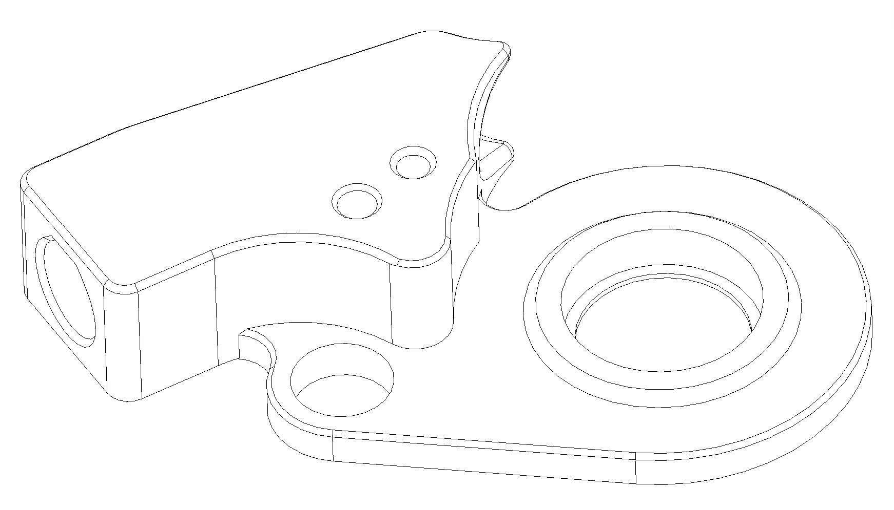
INTRODUCTION
THE PRINT CALIBRATION TOOL
IMPORTANT !! The Filamentalist design relies on multiple press-fits for bearings, axle, and the ECAS04 fitting as well as thread-cut holes. As a result, printer calibration is important. The Print_Calibration_Tool.stl is included. It is highly recommended that you print this block first, check fits, and make adjustments to extrusion multipliers and/or slicer scaling if needed before printing the Filamentalist parts.
M3 Thread Cutting Hole
688/608 Bearing Hole
(easy press fit)
M3 Clearance Hole
ECAS04 Hole
(tight press fit)
8mm Axle Hole
(easy press fit)
Print_Calibration_Tool.stl
TESTS
Insert the different pieces of hardware in their dedicated positions.
The ECAS fitting should be a tight press fit. If the plastic cracks after ECAS insertion or the ECAS is a loose fit then extrusion rates and/or interior hole settings need to be adjusted in your slicer. You may need to cut the print with clippers to remove the ECAS for reuse after checking fit.
You should be able to hand press in a 688/608 bearing into the pocket. It is acceptable if additional force, like light hammer taps is required to fully seat the bearing. The bearing can be removed by inserting an 8mm axle/rod through the bearing and rocking the rod back and forth while gently pulling on the rod, “walking” the bearing out of the pocket.
Screw an M3 screw into the provided 2.7mm diameter hole. The screw should tightly screw in and cut threads into the plastic. If the ECAS and 688/608 bearing press in nicely but this hole is tight, no print adjustments need to be made but M3 screw holes may need to be opened up hand twisting a 2.5mm drill bit.
‹#›

Slide 9
INTRODUCTION
STL FILE NAMING KEY
FILE NAMING
By this time you should have already downloaded our STL files from the ERCF GitHub. This is how to use the naming conventions.
[a]_Part_Name_{Bearing_Size}_{Quantity_Required}_[option].stl
Example [a]_Rim_Roller_688_Bearing_x2.stl
PRIMARY COLOR Example Tensioner_Mount_Std.stl These files will have nothing at the start of the filename. | ACCENT COLOR Example [a]_Tensioner_Arm.stl These files have an ‘’[a]_’’ prefix to denote that they should be printed with an accent color. | BEARING SIZE Filenames with an ‘’688_Bearing’’ or “608_Bearing” after the file name are specific to the bearing size option you choose to build. | QUANTITY REQUIRED Filenames ending with ‘’_x#’’ are telling you the quantity of that part required to build a single rewinder
[option] Filenames with an “[option]” after the filename are build options/alternatives such as: Mount style Pre-gate sensor included in Tensioner Mount Printed clutch vs One-Way bearing
‹#›

Slide 10
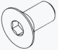
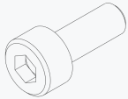
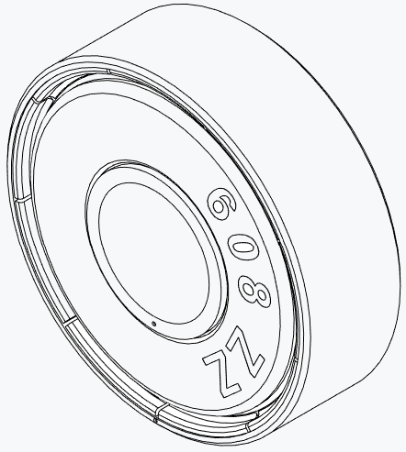
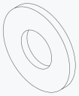
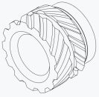
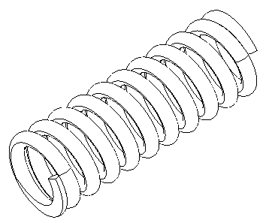
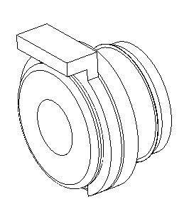
INTRODUCTION
HARDWARE REFERENCE
 | FLAT HEAD COUNTERSUNK SCREW (FHCS) Metric fastener with a cone shaped head and a flat top. ISO 10642 |  | SOCKET HEAD CAP SCREW (SHCS) Metric fastener with a cylindrical head and hex drive. The most common fastener used on the ERCF. ISO 4762
 | WASHER Plain metal stamped washer. DIN 125 |  | 688/608 BEARING For the Filamentalist, the 2RS (sealed) style is preferred but can be used with the open or ZZ (shielded) style.
 | HEAT SET INSERT Brass, threaded, with ridges on the outside. Heat to approx 250C with soldering iron and push into a hole in the plastic. Plastic cools and solidifies around the knurls/ridges for excellent resistance to torque and pull-out. |  | SPRING For the Filamentalist, 304 Stainless Steel,6mm OD, 0.6mm Wire Size, 15mm Free Length spring used in Tensioner Assembly.
 | ECAS FITTING 4mm Push -Fit PTFE tubing fitting.
‹#›

Slide 11
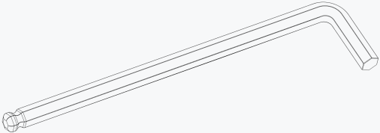
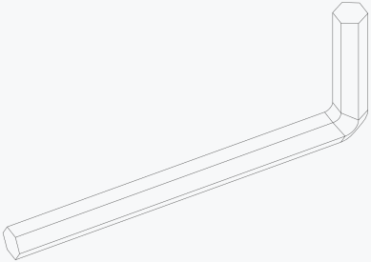
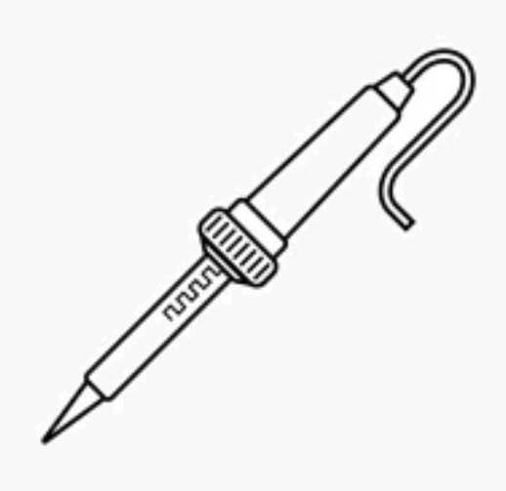
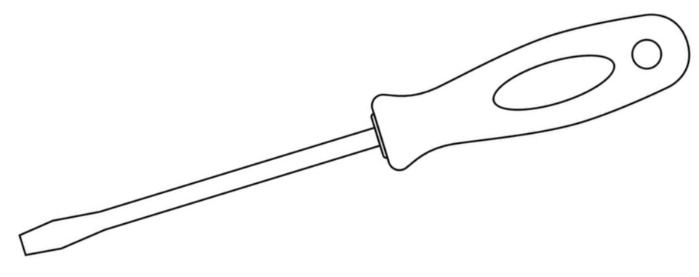
INTRODUCTION
TOOLS
2.5MM HEX DRIVER
Adjustment of the Tensioner screw in this design benefits from the use of a 2.5mm hex driver. The ball-end style is preferred. This driver is also used for the axle set screws on the Rim Rollers.
2MM HEX DRIVER
The 2mm hex driver is used on the M3 FHCS screws in this build.
SOLDERING IRON
For the insertion of the single heat set insert in the Tensioner Mount part.
SMALL FLAT BLADED SCREWDRIVER
To aid in the removal of built-in supports.
‹#›

Slide 12
INTRODUCTION
TOOLS
ANGLE GRINDER/DREMEL
For cutting 8mm axle rods/tubes to length if required.
VISE
A vise is handy cutting 8mm axles and pressing the one-way bearing into the CDR.
CAD SOFTWARE
Filamentalist_V3_688/608_bearing.step or Filamentalist_V3_(parametric).f3d
Software is a tool too! The CAD file for the Filamentalist was designed to be used along with this manual as a supplement or reference, even if you aren’t a CAD Pro. You can use the free edition of Fusion360, or your choice of CAD program such as TinkerCAD, onshape, or FreeCAD.
SUPERGLUE
Yes, we consider this a tool. Superglue may be useful if your print tolerances result in slip-fits for the bearings and ECAS. Cheap, single-use gel tubes are fine.
PRINT CALIBRATION TOOL
https://github.com/Enraged-Rabbit-Community/ERCF_v2/tree/master/Recommended_Options/Filamentalist_Rewinder/Filamentalist_FV3_beta/Stls/Tools
It is highly recommended that you print this Print_Calibration_Tool.stl part first, check fits of M3 screws (both slip fit and thread cutting), 608/688 bearings, 8mm axle lightpress/slip fit, and the ECAS04 press fit. Make adjustments to extrusion multipliers and/or slicer scaling if needed before printing the Filamentalist parts.
‹#›

Slide 13
INTRODUCTION
USING THE CAD FILES
We have provided the Filamentalist CAD files (https://github.com/Enraged-Rabbit-Community/ERCF_v2/tree/master/Recommended_Options/Filamentalist_Rewinder/Filamentalist_FV3_beta/CAD/Filamentalist_V3_beta_###_Bearing_v##.step and Filamentalist_V3_beta_(parametric)_V##.f3d), so that you can follow along with the instructions in a 3D view, if you like.
The CAD file is organized into folders based on assemblies referenced in this manual. First hide all the parts, and then reveal the parts up to the step you are on in this manual, and the CAD should match what you are building.
All of the non-printed parts are in each assembly’s Hardware folder.
‹#›
‹#›
‹#›

Slide 14
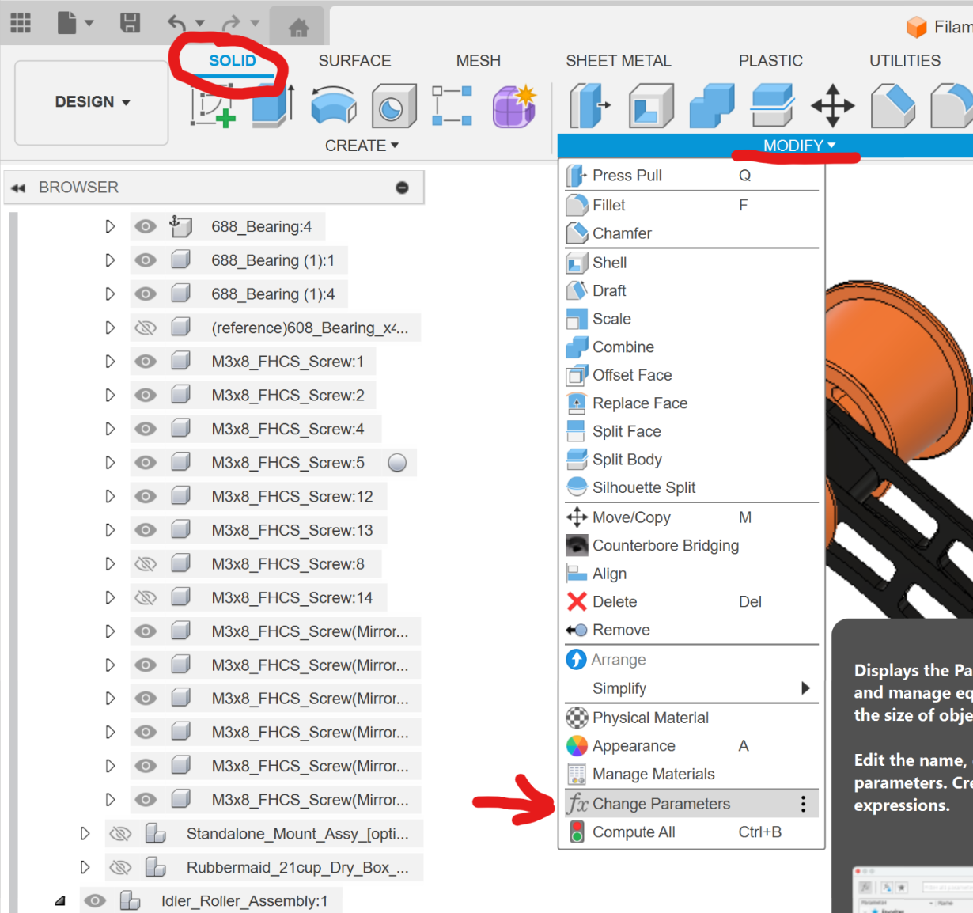
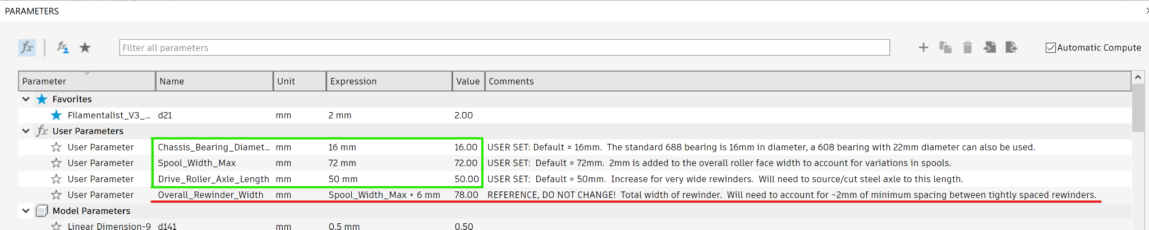
INTRODUCTION
THE PARAMETRIC CAD MODEL
If you are using Autodesk Fusion 360 the “Filamentalist_V3_(parametric).f3d file provided in the CAD folder is a parametric based model allowing you to customize the width of your rewinder to suit your max/min spool widths and/or to design around a standard available steel axle length. The model will update and accurately show the results of these parameters to help you visualize the acceptability of the result as well as provide reference dimensions to aid in part sourcing.
To customize your Filamentalist width and axle sizing, load the model, make sure you are in the "Solid" menu, and then select "Modify" and "Change Parameters"
Adjust the following parameters to meet your needs:
Chassis Bearing Diameter - Set to 16mm if you are using 688 bearings for the Drive and Idler axles or 22mm for 608 bearings. This setting creates unique Chassis_L/R, Rim Roller, and Rear Filamentalist Enclosure Mount parts. Any other setting than 16 or 22mm will result in errors in the model.
(parameter descriptions continued on next page)

Slide 15
INTRODUCTION
THE PARAMETRIC CAD MODEL (continued)
Adjust the following parameters to meet your needs (continued from previous page):
Spool_Width_Max - The default is 72mm which should accommodate 99% of the 1KG spools on the market. Set this to accommodate the widest filament spool you expect to use. 2mm will be added to this number in the design to allow for spool width and rim straightness/variation.
Drive Roller Axle Length - The default is 50mm. If you already have 80mm axles from the Classic Filamentalist version these can be used with no need to change the parameters in the model. Changing this setting allows you to visualize how a custom (long) axle length will fit, especially if you increase the Spool_Width_Max parameter for a custom wide rewinder.
Overall_Rewinder_Width: REFERENCE PARAMETER. DO NOT CHANGE THIS! This is included as an aid to assess the results of your inputs. You can iterate with changes to the above user inputs to arrive at the desired Overall Rewinder Width for your space, enclosure. Or application.
The model will update to show the results of these parameters to help you visualize the acceptability of the result.

Slide 16
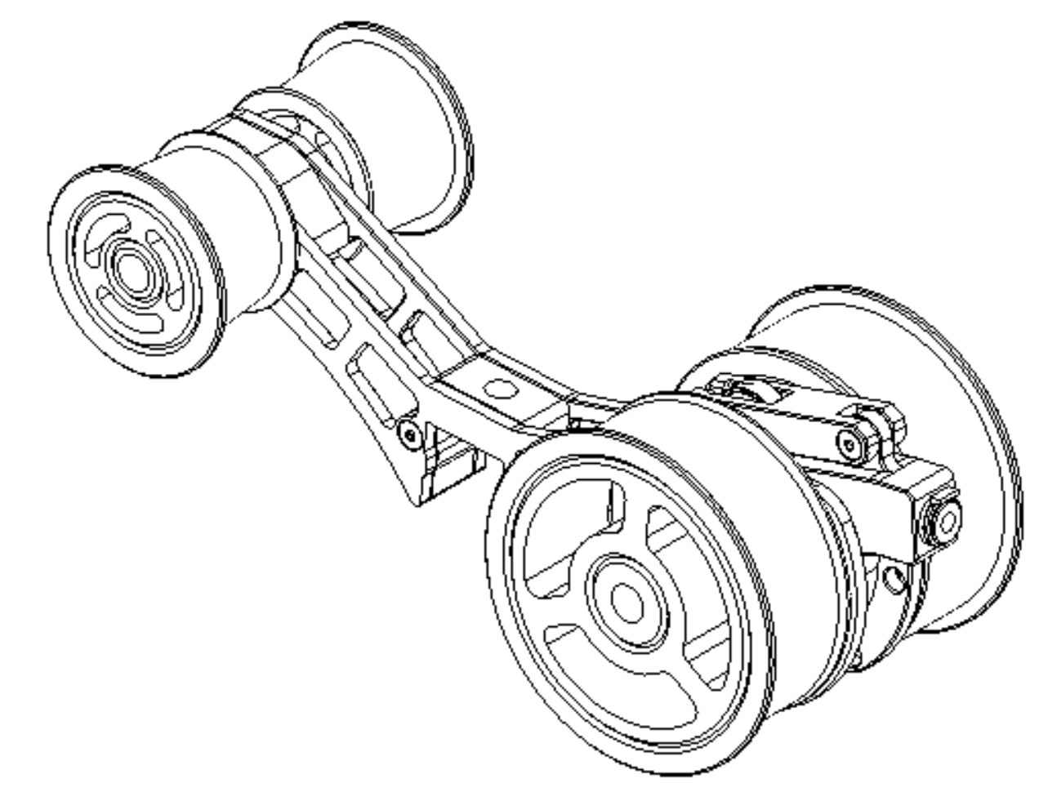
FILAMENTALIST V3 REWINDER ASSEMBLY
OVERVIEW
Idler Roller Assembly
Tensioner Arm
Assembly
Chassis Assembly
Drive Roller
Assembly
Tensioner Mount
Assembly

Slide 17
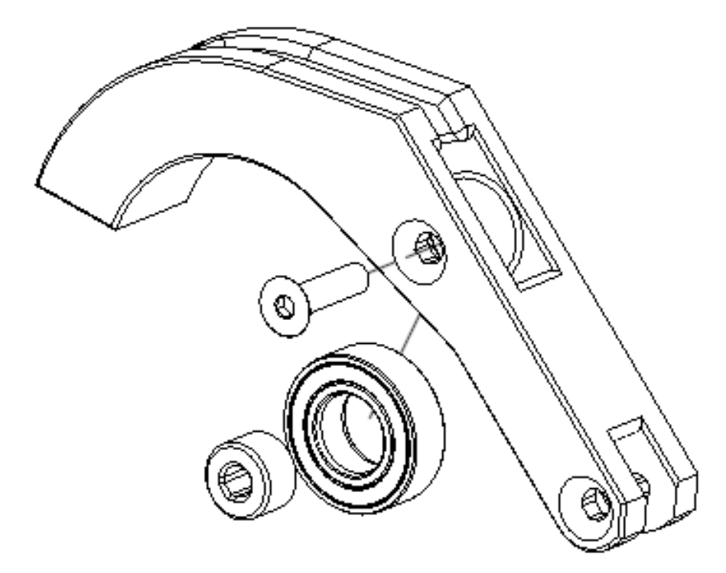
TENSIONER ARM ASSEMBLY
EXPLODED VIEW
TENSIONER ARM ASSEMBLY BOM
(PER REWINDER)
A
B
1x 688 Bearing
2x M3x12 Flat Head Cap Screw (FHCS)
TENSIONER ARM ASSEMBLY PRINTED PARTS
(PER REWINDER)
1x [a]_Tensioner_Arm.stl
1x 688_Bearing_Bushing.stl
C
D
C
B
D
A
ASSEMBLY INSTRUCTIONS
Insert the 688 Bearing Bushing printed part into 688 bearing bore and slide up into Tensioner Arm printed part.
Place M3x12 FHCS screw into Tensioner Arm and through the 688 Bearing Bushing and 688 Bearing, cutting threads into plastic of the Tensioner Arm. Only moderate force is required to cut the threads and secure the 688 bearing. Turning the screw with too much force will strip out the plastic threads.

Slide 18
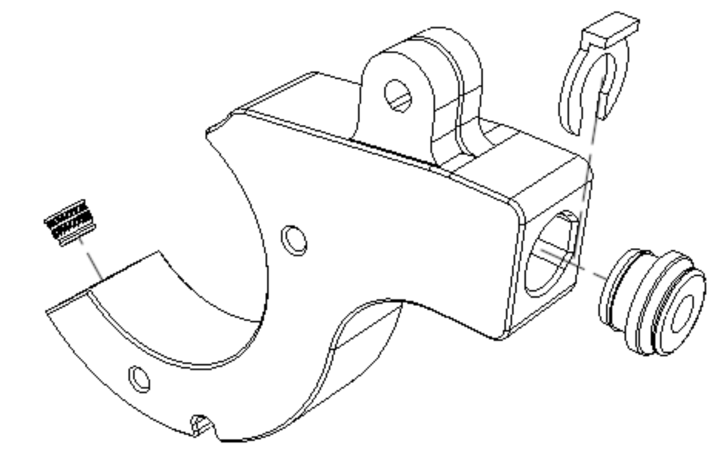
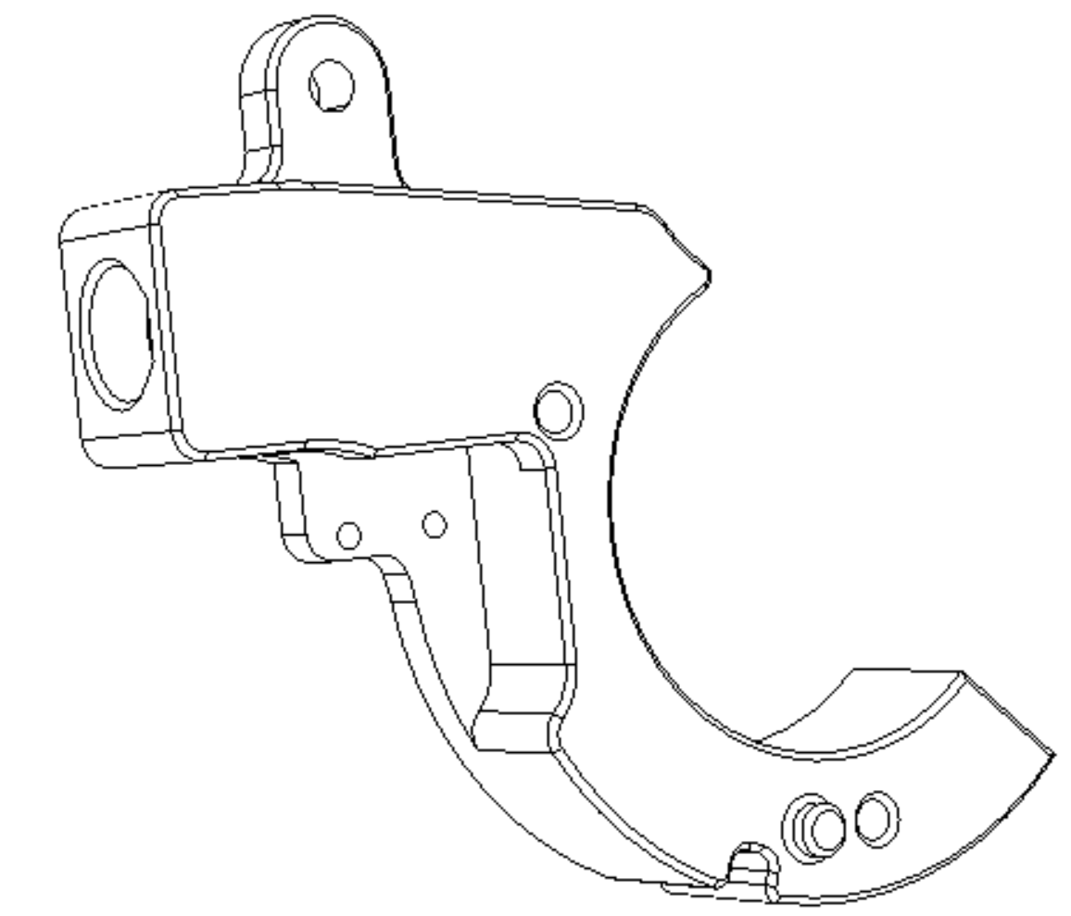
TENSIONER MOUNT ASSEMBLY
TENSIONER MOUNT ASSEMBLY BOM
(PER REWINDER)
EXPLODED VIEW
A
B
C
1x Heat Set Insert
1x ECAS04
1x ECAS04 Locking Clip
E
D
TENSIONER MOUNT ASSEMBLY PRINTED PARTS
(PER REWINDER)
A
1x Tensioner_Mount_Std.stl
or
1xTensioner_Mount_Microswitch_[option].stl
1x [support]_Tensioner_Mnt_Std.stl (part of the Tensioner_Mount stl but needs to be included if making stl from CAD files)
C
D
E
Support removal notch
B
Tensioner_Mount_Microswitch_[option].stl
ASSEMBLY INSTRUCTIONS
Remove built-in support (part E) from Tensioner Mount part. A small flat bladed screwdriver placed in the notch works well.
Install the heatset insert into the Tensioner Mount part.
Insert the ECAS04 into the Tensioner Mount. This should be a tight press fit. One method for installing is to place the ECAS04 on a sturdy surface like a table or counter top and press the Tensioner Mount part downward onto the ECAS04. Ensure the ECAS04 is fully seated against, and aligned to the face of the Tensioner Mount.
Although not necessary to install now, use of an ECAS04 locking Clip is required once PTFE tubing is installed.

Slide 19
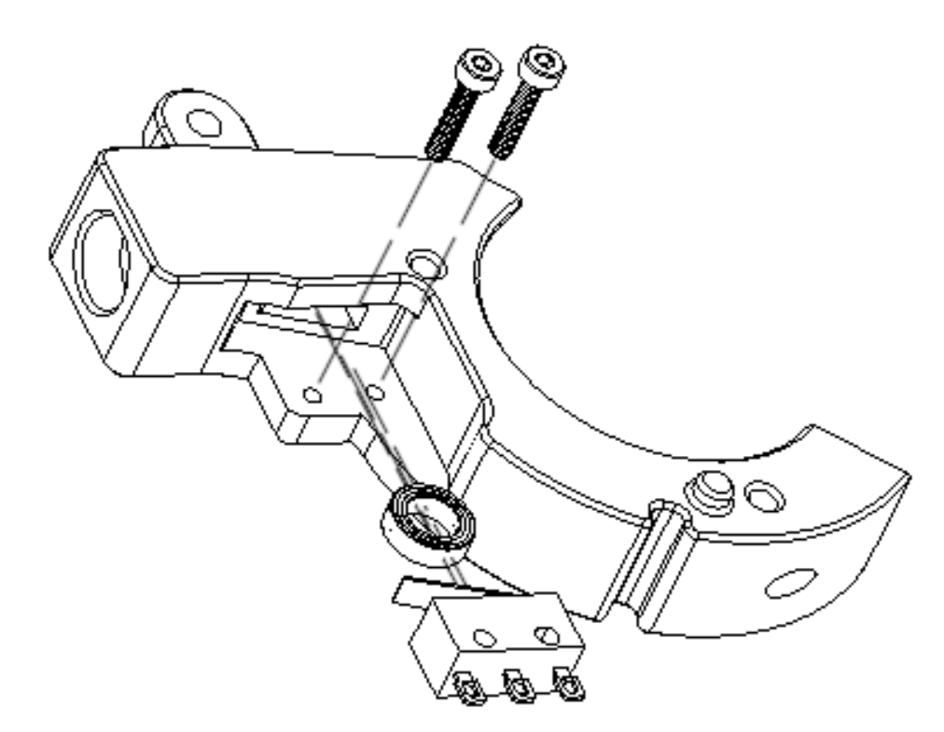
[OPTIONAL] TENSIONER MOUNT MICROSWITCH
ASSEMBLY
TENSIONER MOUNT ASSEMBLY BOM
(PER REWINDER)
EXPLODED VIEW
A
B
C
1x D2F-01FL-D3 Microswitch
1x MR85 Bearing
2x M2x8 screws (SHCS or BHCS)
D
TENSIONER MOUNT ASSEMBLY PRINTED PARTS
(PER REWINDER)
C
1x 1xTensioner_Mount_Microswitch_[option].stl
D
B
A
ASSEMBLY INSTRUCTIONS
Install the MR85 bearing into the slot in the Tensioner Mount part.
Install the Microswitch into the Tensioner Mount with the lever facing towards the ECAS04 hole in the Tensioner Mount using the M2 screws cutting threads into the plastic.

Slide 20
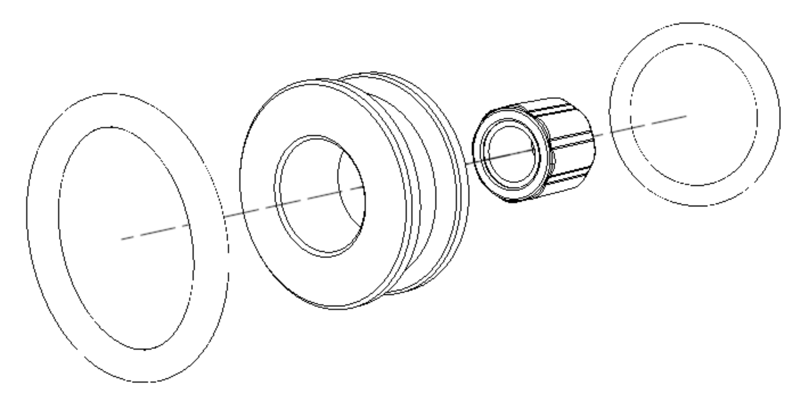
CENTER DRIVE ROLLER (CDR) ASSEMBLY
TENSIONER ARM ASSEMBLY BOM
(PER REWINDER)
EXPLODED VIEW
C
A
B
1x 1-Way Bearing
2x O-Ring
TENSIONER ARM ASSEMBLY PRINTED PARTS
(PER REWINDER)
1x CDR.stl
or
1x CDR_Printed_Clutch_Assy_[option]
A
C
B
ASSEMBLY INSTRUCTIONS
Press the 1-Way Bearing into the CDR part. A bench vise, c-clamp, quick-grip/trigger ratcheting clamp, or soft jaw pliers can be used. Ensure the 1-Way bearing is centered within the CDR.
Stretch the (2) o-rings onto the CDR.

Slide 21
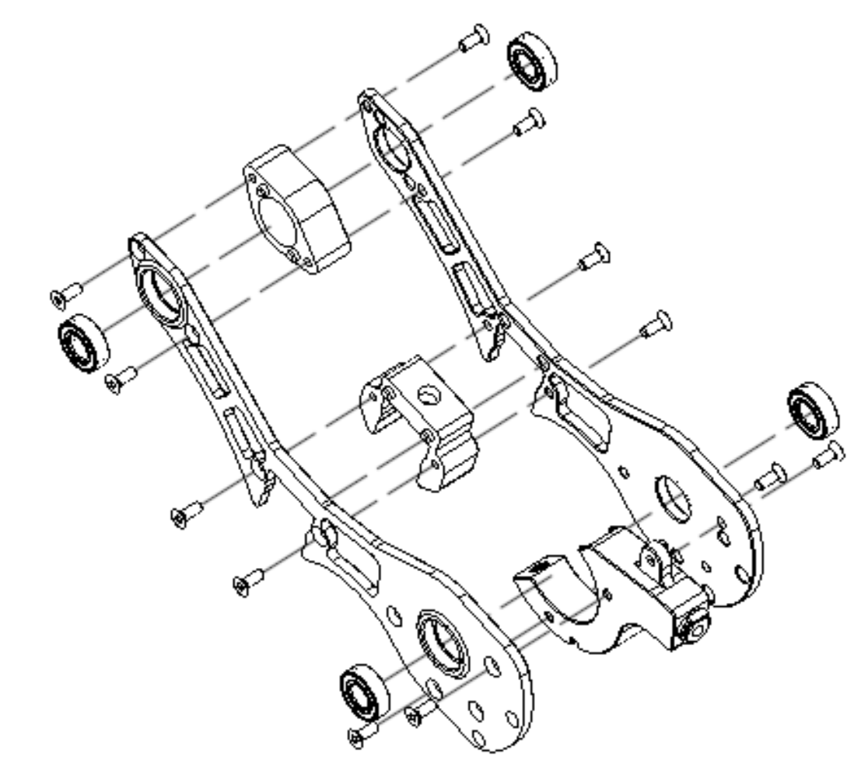
CHASSIS ASSEMBLY OVERVIEW
CHASSIS ASSEMBLY BOM
(PER REWINDER)
EXPLODED VIEW
A
B
C
4x 688/608 Bearing
12x M3x8mm Flat Head Cap Screw (FHCS)
Tensioner Mount Assembly
G
CHASSIS ASSEMBLY PRINTED PARTS
(PER REWINDER)
1x Chassis_L.stl
1x Chassis_R.stl
1x 2020_Mnt_Center_Spacer.stl
(or, mount options pg. 23)
1x 2020_Mnt_Spacer_Rear.stl
(or, mount options below pg. 23)
D
E
F
G
F
D
A
B
C
E

Slide 22
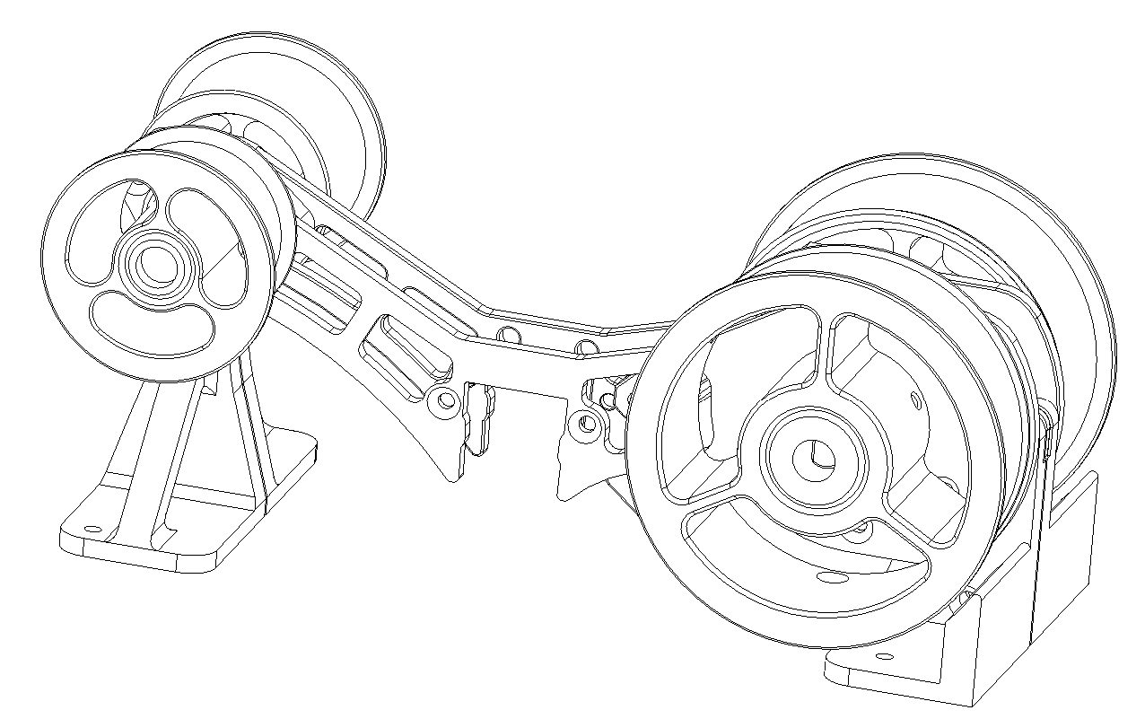
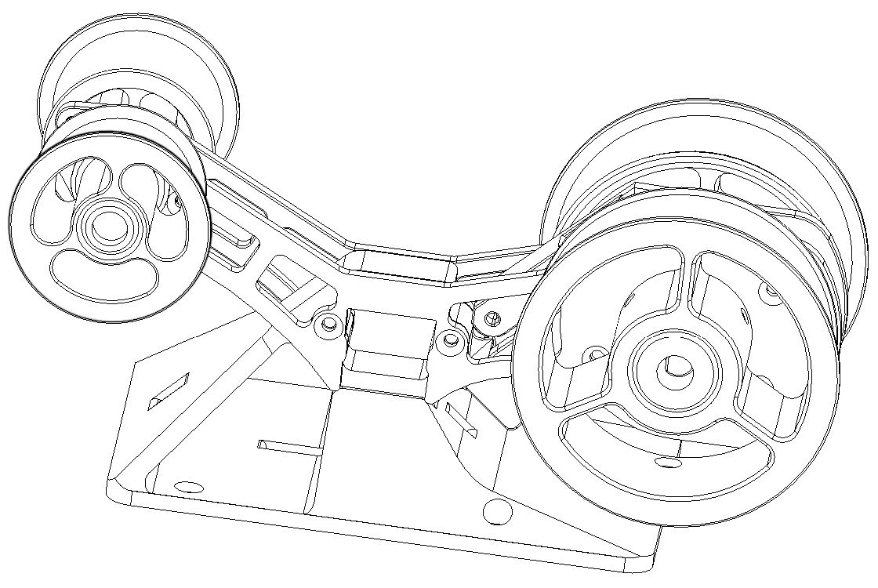
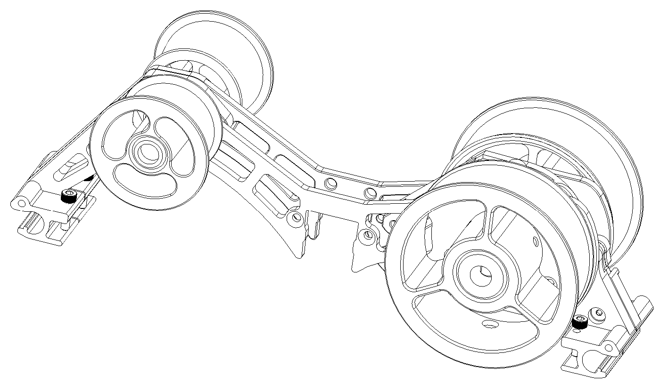
CHASSIS MOUNT OVERVIEW (Rear Load configuration shown)
STANDALONE FRONT/REAR MOUNT
STANDALONE CENTER MOUNT
STANDALONE FRONT/REAR MOUNT BOM
(PER REWINDER)
A
2x M3x8mm Flat Head Cap Screw (FHCS)
STANDALONE FRONT/REAR MOUNT PARTS
(PER REWINDER)
1x Standalone_Mnt_Rear_R_[option]
1x Standalone_Mnt_Rear_R_[option]
1x Standalone_Mnt_Front_R_[option]
1x Standalone_Mnt_Front_L_[option]
B
C
D
E
B
C
F
A
D
STANDALONE CENTER MOUNT PARTS
(PER REWINDER)
E
1x Standalone_Cntr_Mnt_[option].stl
F
FILAMENTALIST ENCLOSURE MOUNT BOM
(PER REWINDER)
FILAMENTALIST ENCLOSURE MOUNT
A
A
B
2x M3x8mm Flat Head Cap Screw (FHCS)
4x M3x12mm Socket Head Cap Screw (SHCS)
FILAMENTALIST ENCLOSURE MOUNT PARTS
(PER REWINDER)
A
1x Fil_Encl_Rear_Mnt_R_[option]
1x Fil_Encl_Rear_Mnt_L_[option]
1x Fil_Encl_Frnt_Mnt_R_[option]
1x Fil_Encl_Frnt_Mnt_L_[option]
B
B
C
D
E
C
B
D
E

Slide 23
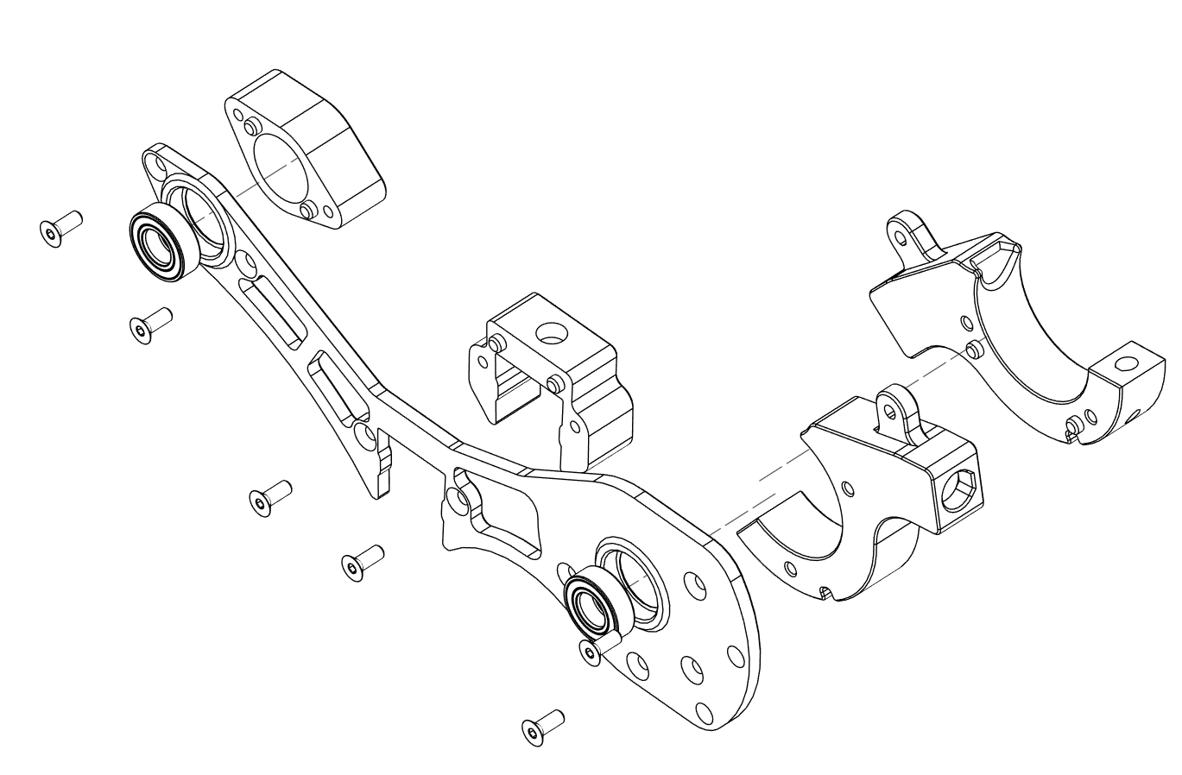
CHASSIS ASSEMBLY - STEP 1
EXPLODED VIEW
CHASSIS ASSEMBLY BOM
(PER REWINDER)
A
B
C
2x 688/608 Bearing
6x M3x8mm Flat Head Cap Screw (FHCS)
Tensioner Mount Assembly
G
C
(REAR LOAD ORIENTATION)
CHASSIS ASSEMBLY PRINTED PARTS
(PER REWINDER)
1x Chassis_R.stl
1x 2020_Mnt_Center_Spacer.stl
(or, see Chassis Mount options pg. 23)
1x 2020_Mnt_Rear_Spacer.stl
(or, see Chassis Mount options pg. 23)
F
E
F
G
A
B
E
C
(FRONT LOAD ORIENTATION)
ASSEMBLY INSTRUCTIONS
Hand press (2) 688 or 608 bearings (depending on version printed) into the bearing pockets of the Chassis_R part.
Align the pegs of 2020_Mnt_Rear_Spacer with the peg pockets in Chassis_R and secure with (2) M3x8mm FHCS screws.
If using Filamentalist Enclosure mounts use Fil_Encl_Rear_Mnt_R_[option] in place of the Spacer part (see next page).
Align the pegs of 2020_Mnt_Center_Spacer with peg pockets in Chassis_R part and secure with (2) M3x8mm FHCS screws.
If not mounting to a 2020 center rail and you want a stiffer chassis, install the 1x Chassis_Cntr_Spacer_[option]. If using the center Standalone mount then install the 1x Standalone_Mnt_R_[option]
Or, if using the Standalone mount install the Standalone_Cntr_Mnt part.
Secure the Tensioner Mount assembly with (2) M3x8mm FHCS screws in either the front or rear load orientation.

Slide 24
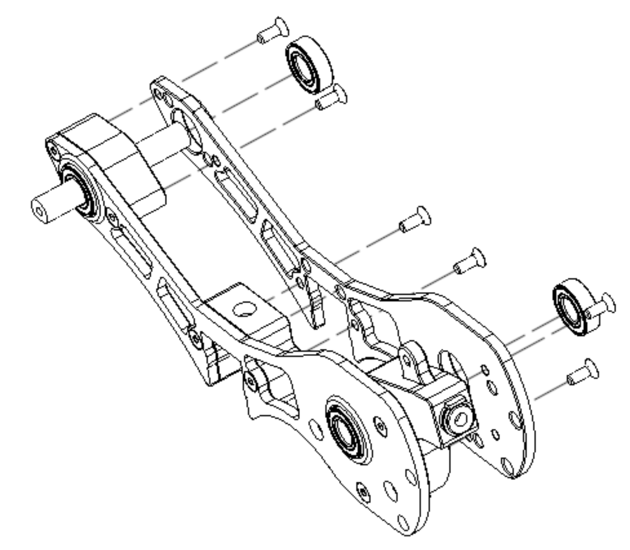
CHASSIS ASSEMBLY - STEP 2
EXPLODED VIEW
CHASSIS ASSEMBLY BOM
(PER REWINDER)
A
B
C
2x 688/608 Bearing
6x M3x8mm Flat Head Cap Screw (FHCS)
Tensioner Mount Assembly
G
B
H
D
CHASSIS ASSEMBLY PRINTED PARTS
(PER REWINDER)
A
1x Chassis_L.stl
1x 2020_Mnt_Center_Spacer.stl
1x 2020_Mnt_Rear_Spacer.stl
1x Idler_Roller_Axle.stl
D
F
G
H
F
ASSEMBLY INSTRUCTIONS
C
Hand press (2) 688 or 608 bearings (depending on version printed) into the bearing pockets of the Chassis_L part.
Insert the Idler_Roller_Axle part through the 2020_Mount_Rear_Spacer part and bearing.
If using the Filamentalist Enclosure or Front/Rear Standalone Mount options (see pg. 23) screw the two front mounts together with a M3x8 FHCS screw and insert into the peg holes at the front of the Chassis_R part.
Secure the Chassis_L part with (6) M3x8mm FHCS screws at the 2020_Mnt_Center_Spacer, 2020_Mnt_Rear_Spacer, and Tensioner Mount Assembly aligning hole locations.

Slide 25
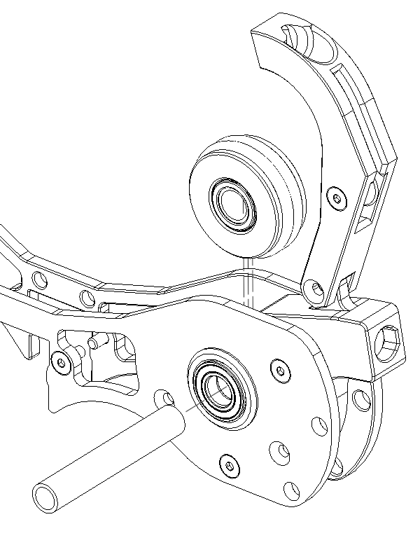
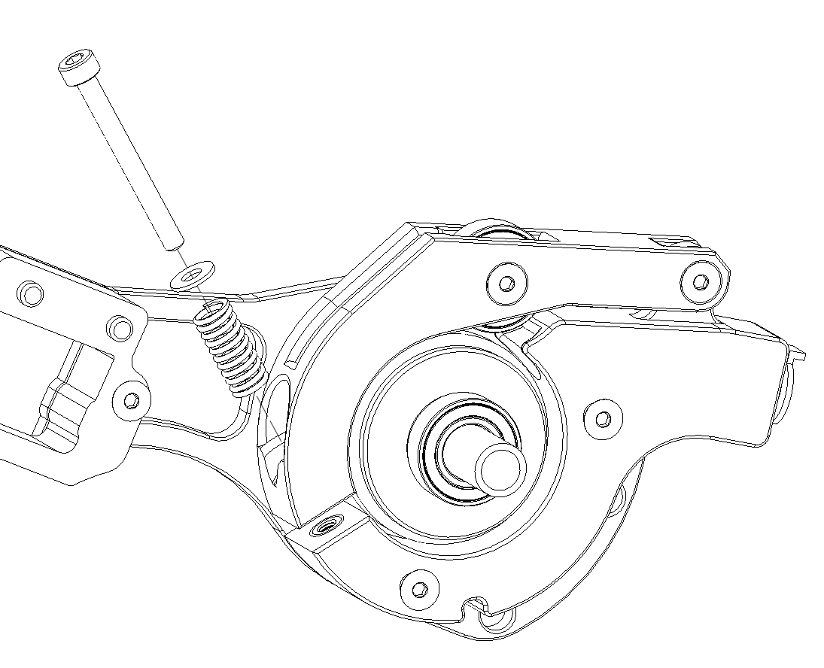
CDR/TENSIONER ARM ASSEMBLY
CDR/TENSIONER ARM BOM
(PER REWINDER)
EXPLODED VIEWS
A
B
C
D
E
F
G
1x CDR Assembly
1x Tensioner Arm Assembly
1x 8mm Steel Axle
1x M3x12mm Flat Head Cap Screw (FHCS)
1x M3x30mm Socket Head Cap Screw (SHCS)
1x M3 Washer
1x Spring
B
A
F
D
E
C
G
ASSEMBLY INSTRUCTIONS
Attach Tensioner Arm Assembly with 1x M3X12mm Flat Head Cap Screw (FHCS)
Check for correct CDR/One-Way bearing orientation per pg. 27 and then drop CDR Assembly into Tensioner Mount “pocket”.
Insert 8mm axle through chassis bearings and CDR assembly.
Verify correct CDR/One-Way bearing orientation per pg. 27 and repeat steps 2 and 3 if necessary.
Place an M3 washer followed by the spring onto a M3x30 SHCS screw, insert through slot in Tensioner Arm, and screw into heat set insert in the Tensioner Mount (leave spring untensioned for now).

Slide 26
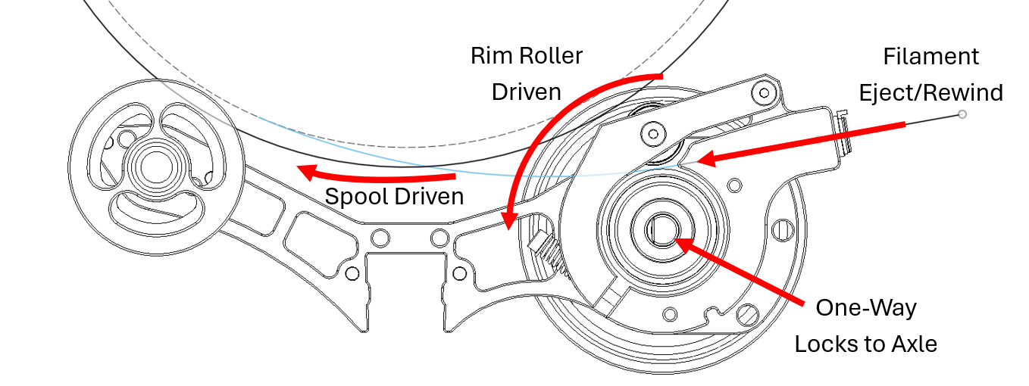
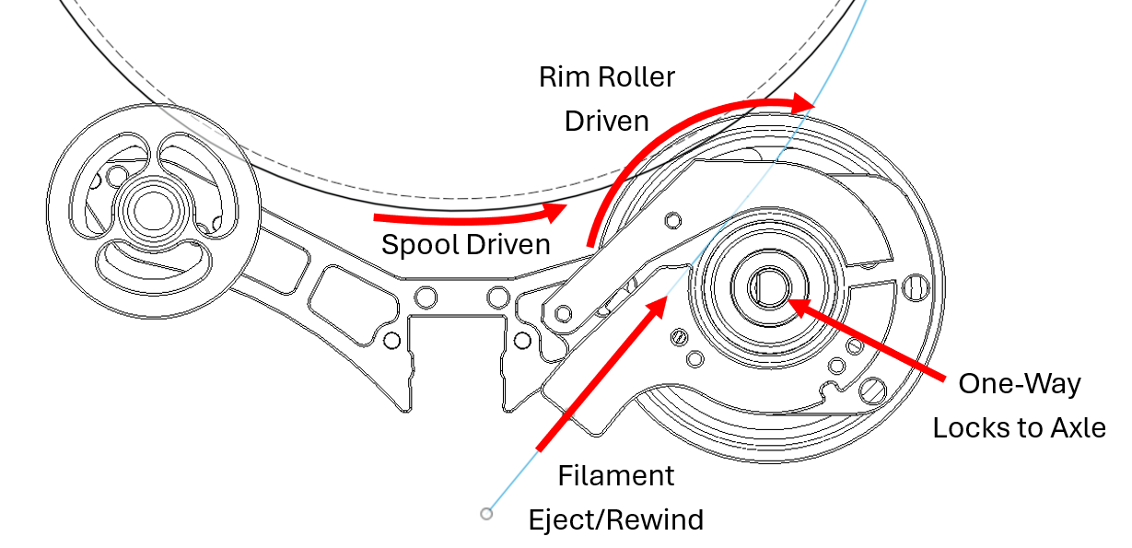
ONE-WAY BEARING ORIENTATION
FRONT LOAD CONFIGURATION
REAR/BOTTOM LOAD CONFIGURATION
One-Way bearing locks when Rim Roller/Axle is held and Center Drive Roller is rotated in the direction of filament unload/eject (in the pictures above clockwise for front load configuration, counter clockwise for rear/bottom load)

Slide 27
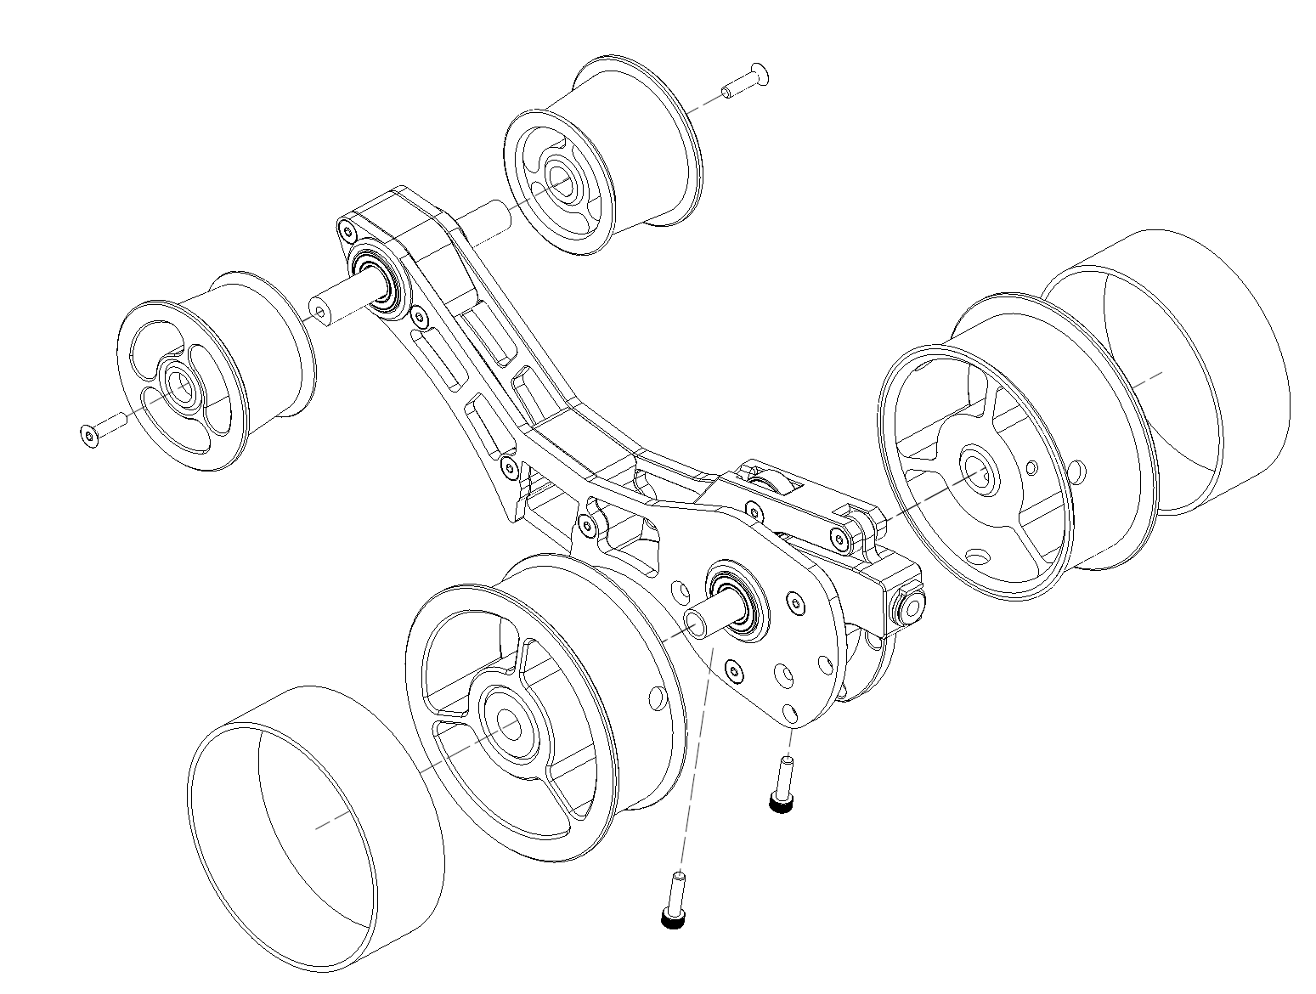
RIM/IDLER ROLLER ASSEMBLY
RIM/IDLER ROLLER BOM
(PER REWINDER)
EXPLODED VIEW
A
B
C
2x Rubber Band
2x M3x12-16mm Screw (Socket Head preferred)
2x M3x12mm Flat Head Cap Screw (FHCS)
E
C
RIM/IDLER ROLLER PRINTED PARTS
(PER REWINDER)
2x Rim Roller
2x Idler Roller
D
E
D
A
B
ASSEMBLY INSTRUCTIONS
Stretch Rubber Bands onto Rim Rollers.
Ensure axle is centered within the chassis bearings within +/-1mm.
Slide Rim Rollers onto steel axle and snugly against chassis bearings. Insert M3 screws (length 12mm through 16mm) and tighten with moderate pressure against axle.
Slide Idler Rollers onto Idler Axle. Drive M3x12mm FHCS screws will be driven through the thin support web on the Idler Roller and into the Idler Axle.

Slide 28
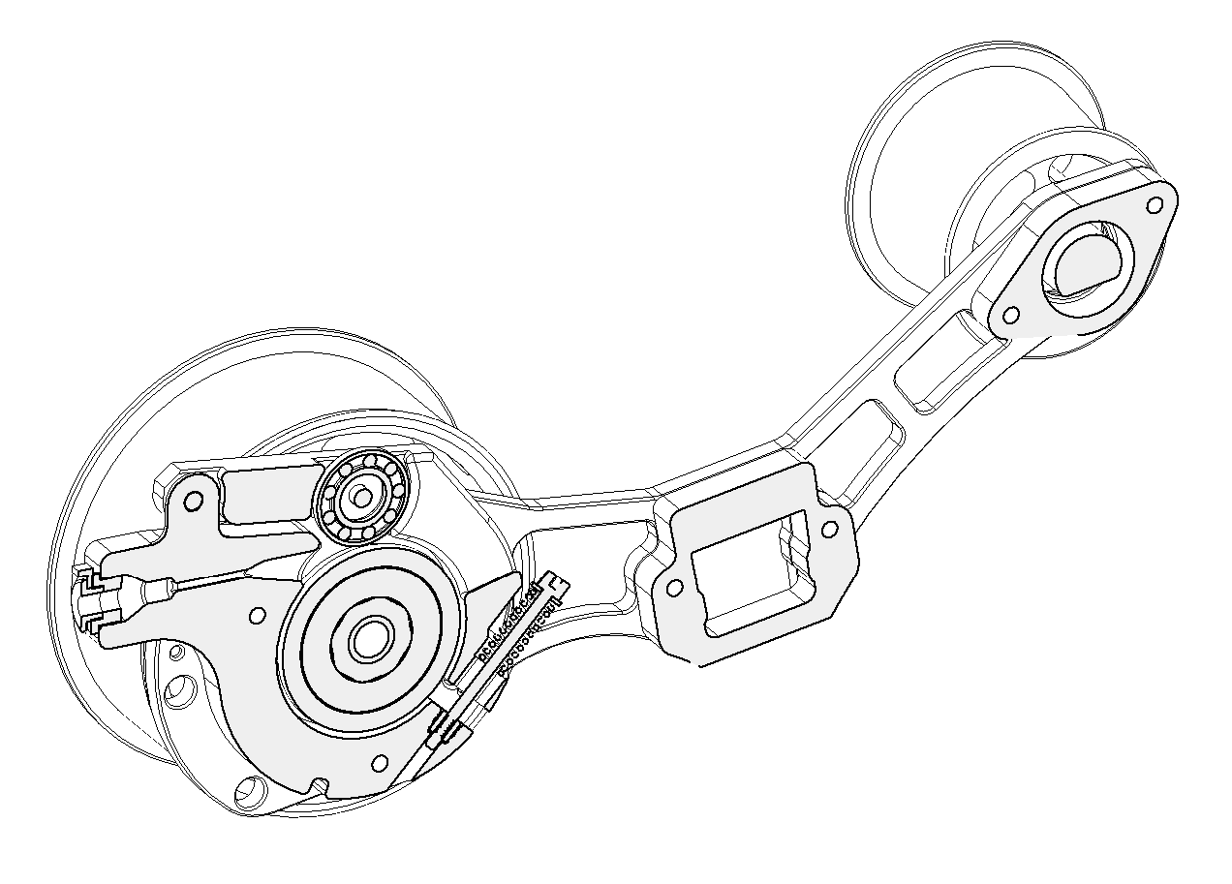
TUNING INSTRUCTIONS
Tune by setting the Tensioner Arm clamping force. The Tensioner Arm does not need an extreme amount of tension.
As a bench test (not connected to the MMU yet), insert an ~500mm length of filament into the Tensioner Arm slot, through the o-ring/bearing interface, and out the ECAS side of the Tensioner Mount.
Hold one RimRoller and try to pull the filament out in the eject direction.
The slip force/resistance should “light-to-moderate” (~0.2-0.3 kg or ~7-10 oz). Adjust the spring tensioner screw accordingly and err on the light side for a starting point.
Once a spool is loaded on the rewinder pull ~1m of filament in the load direction. Filament should stay tight on the spool (no loose loops). If loose loops form this indicates that the One-Way Bearing/Center Drive Assembly may be installed backwards (return to CDR/TENSIONER ARM ASSEMBLY step), or the One-Way bearing is too tight on the Center Drive Roller Axle (see Filamentalist Troubleshooting Guide .).
Starting with a tightly packed filament roll, push filament back onto the spool to simulate an MMU unload/eject. If loose filament is forming around the filament spool during unload, tighten the spring tensioning screw. If no loose filament is forming around the filament roll, gradually reduce the spring tension until loose filament starts to accumulate and then increase tension in ~1/2 screw turn increments until you feel you have the lightest tension that results in a tightly packed unload.
Initial tuning is complete and the rewinder can now be installed into your system. Steps 4 and 5 above can be followed after rewinder installation if additional tuning is required.
Feed filament through slot in Tensioner Arm
Filament unload/eject direction
Filament load/extrude direction

Slide 29
O-RING REPLACEMENT
You may never need to replace o-rings. Testing and extrapolation estimates that the wear-out point is greater than 5000 cycles. The impact of o-ring wear-out can be reduced by periodically swapping highly used rewinders with low use rewinders in your line-up. Also, o-rings with grooves worn in them can be swapped with their opposing partners to present the unworn side/face to the filament to extend the life of a set. For o-ring replacement, FOLLOW THE STEPS BELOW:
Remove one Rim Roller and slide drive axle out of the rewinder.
Unscrew the M3x30mm Tensioner Screw, pivot the Tensioner Arm out of the way, and remove the CDR Assembly.
Remove the old o-rings (a dental pic or small flat bladed screwdriver works great).
Install a new pair of o-rings or reposition the worn o-rings to present unworn surfaces to the filament interface.
Replace the “fresh” CDR Assembly bak into the rewinder verifying that the Center Drive Roller Assembly/One-Way Bearing is in the correct orientation (see pg. 27) and reassemble the unit.

Slide 30
Questions, Troubleshooting, and Help
If your rewinder is not functioning properly please reference the Troubleshooting guide on Github here: https://github.com/Enraged-Rabbit-Community/ERCF_v2/blob/master/Recommended_Options/Filamentalist_Rewinder/troubleshoot.md
A video demonstrating the heat rework procedure for tight one-way bearings can be found at 4:20 in the Assembly Video here: https://youtu.be/-1cHOcnosxE
Common questions are answered in the FAQ on Github here: https://github.com/Enraged-Rabbit-Community/ERCF_v2/blob/master/Recommended_Options/Filamentalist_Rewinder/Filamentalist_FAQ.md
There is an active community supporting and improving the Filamentalist rewinder on Discord here: https://discord.gg/hxe9eMWseT

